Slide 1
Module 2: Networking Fundamentals (Essential for Hacking)

Slide 2
Introduction to Computer Network

Slide 3
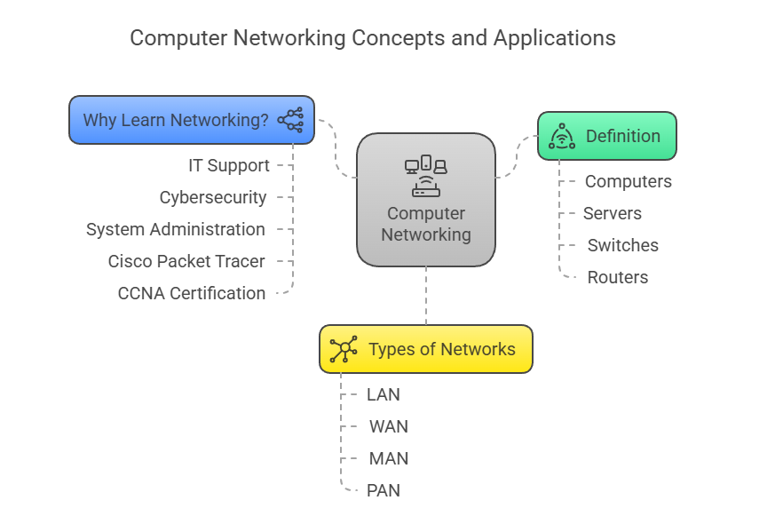
©️Naimul Islam Mehedi

Slide 4
Introduction to Computer Network

